Slide 1

Agentic AI: YouTube Video Analyzer
Presented BY: Tarun Singh Project: IBM PBEL Genertive-AI Project College:United INSTITUTE OF TECHNOLOGY,PRAYAGRAJ

Slide 2
Problem Statement
Manual analysis of YouTube videos is time-consuming
Fragmented Tools: Existing tools may provide either transcript or summary, but rarely both, and rarely financial insights.
Lack of Automation: No single platform integrates transcript extraction, summarization, financial analysis, and visualization in one seamless workflow.

Slide 3
Objectives
Automate YouTube Video Analysis:Extract transcripts and generate concise summaries automatically.
Provide Download Options
Generate Actionable Insights:Highlight key points, topics, and learning takeaways from video content.
Evaluate Financial Impact

Slide 4
Technology Used
Python 3.11
Streamlit
Deep Translator / Google Translator
GROQ LLM (for summarization and insight extraction)
Pandas
YouTube Transcript API
Altair
FPDF

Slide 5
Technology Used For
Python 3.11 – Core programming language for data processing and AI integration.
Streamlit – For interactive web-based user interface and visualization.
Groq AI (llama-3.1-8b-instant) – Generates concise summaries and key insights from transcripts.
Pandas – For handling structured data (e.g., financial info extraction).
Altair – For creating interactive bar charts and graphs for financial impact.
FPDF – Generate downloadable PDF reports for summaries and insights.

Slide 6
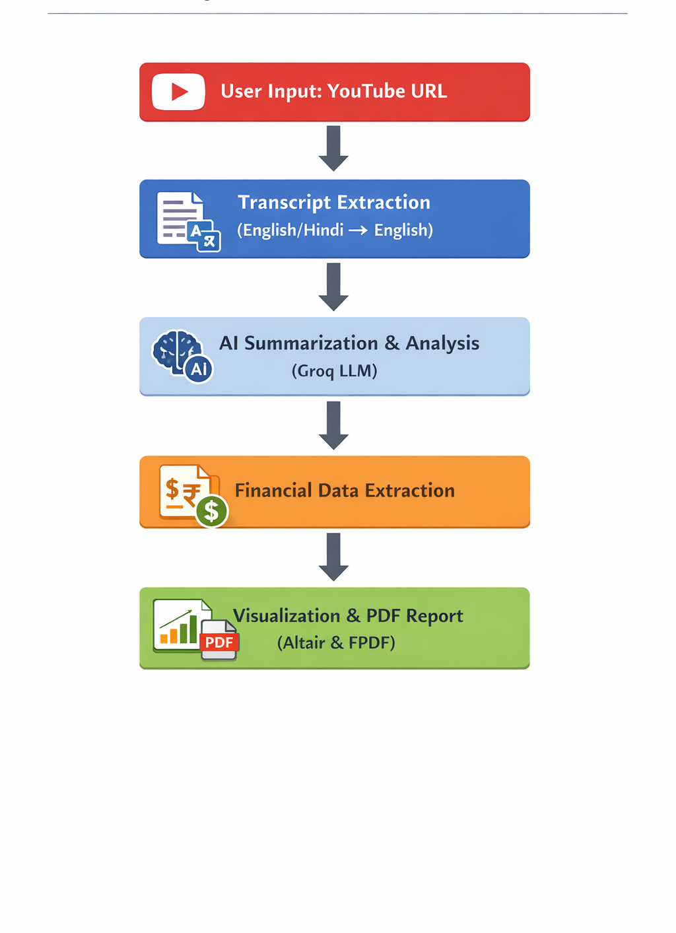
System Architecture

Slide 7
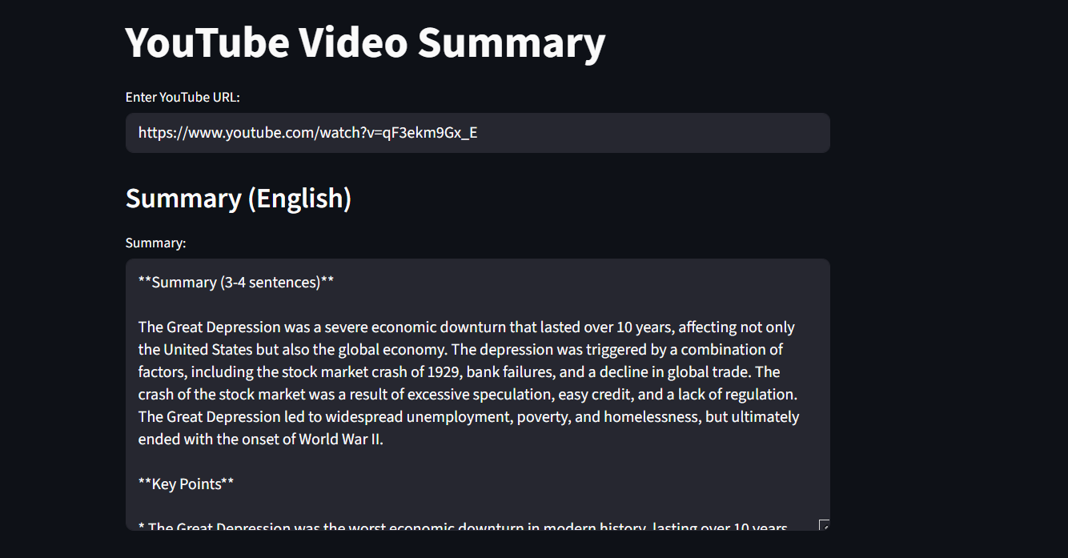
Results

Slide 8
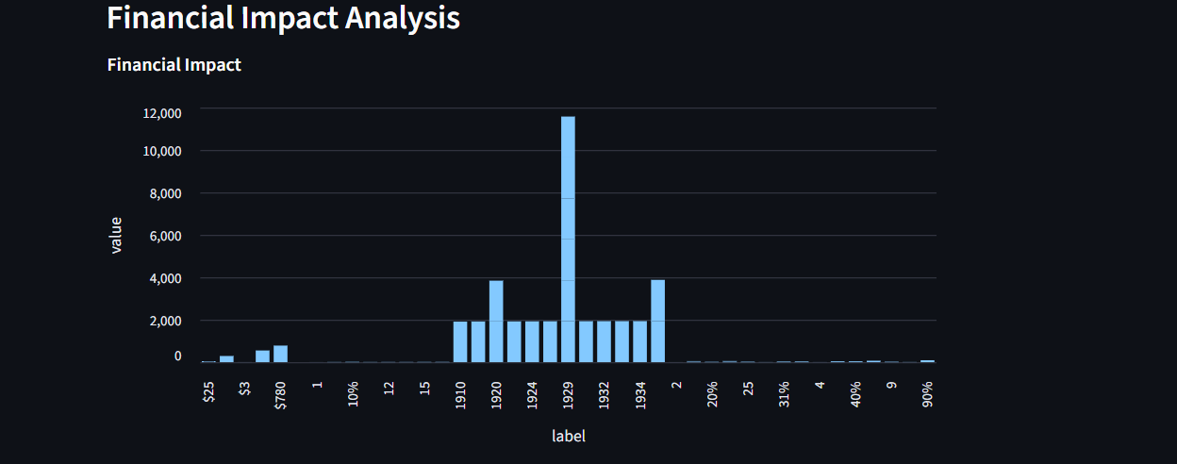
Financial Impact Example

Slide 9
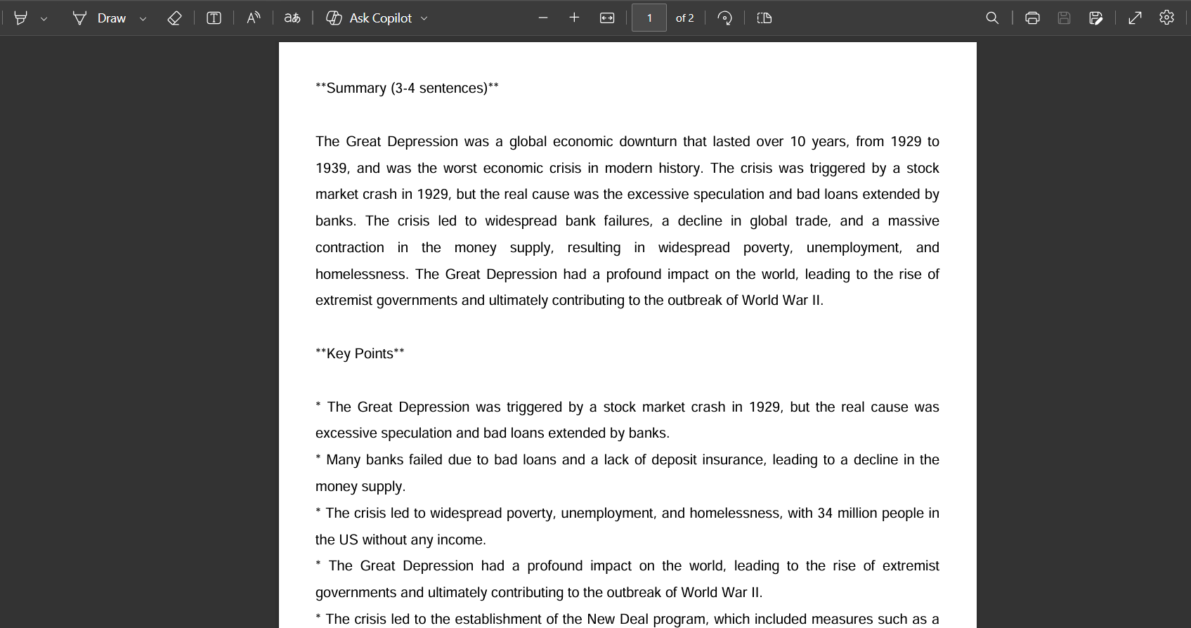
Download result

Slide 10
Conclusion
It generates concise AI-driven summaries, highlighting key points, main topics, and learning insights.
It generates concise AI-driven summaries, highlighting key points, main topics, and learning insights.
Users can download summaries as PDFs, enabling easy reporting and documentation.
The YouTube Video Analyzer effectively extracts multilingual transcripts (Hindi/English) and converts them to English.

Slide 11
Future Scope
Extended Language Support: Integrate more languages beyond Hindi and English.
Real-time Analysis: Process live streams and short clips with instant summarization.
Advanced Financial Analytics: Include trend predictions, ROI calculations, and scenario analysis..
Enhanced Visualization: Interactive dashboards for multiple videos and comparative insights.

Slide 12
Your best quote that reflects your approach… “It’s one small step for man, one giant leap for mankind.”
- Neil Armstrong

